Slide 1
general security concepts
security controls
  measures used to protects assets- i.e data, physical property, or computer systems.
  ensure confidentiality, integrity, availability, and non-repudiation (ensures action cant be denied.
  help prevent security incidents, reduce their impact and limit damage.

Slide 2

CONTROL CATEGORIES
  technical controls also known as logical controls. implemented to manage and reduce risks using computer systems such as hardware, software, or firmware. e.g. firewalls, AV Software, access control, least privilege, IDS & IPS, encryption, Radius servers, RAID arrays etc,
  Radius servers fall under access control.
  RAID arrays fall under data protection and availability

Slide 3
Radius Server
  stands for Remote Authentication Dial-In User Service.
  Controls network access against unauthorised access
  Verifies users' identities before granting network access.
Imagine you arrive at work and connect to the company's Wi-Fi.
  You enter your username and password.
  The network asks the RADIUS server to check your login details.
  The server verifies whether you are authorised.
  If your details are valid, you are allowed to connect. If not, access is denied.

Slide 4
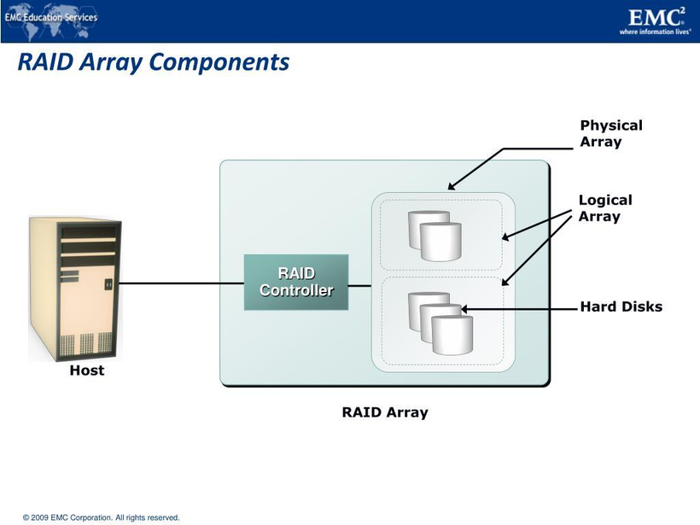
RAID Arrays
  RAID stands for Redundant Array of Independent Disks.
  A RAID array combines multiple hard drives or solid-state drives to improve data reliability, performance, or both, depending on how it is configured.
Why is it a technical control?
It can improve data availability and protect against data loss caused by certain hardware failures.

Slide 5
  operational controls are procedures and measures that are designed to protect data on a day-to-day basis. Are mainly governed by internal processes and human actions. e.g. user access reviews, log monitoring, and vulnerability management, awareness and training, configuration management, media protection, physical and environmental protection
  managerial controls a.k.a administrative controls are all about the mechanics of risk management process such as identifying risks and choosing the right control. often linked to security policies and standard operating procedures. e.g. risk assesments, vulnerability assessments, security awareness training, formal change management.

Slide 6

  physical controls limit physical access using the built environment to enhance safety and prevent crime. e.g. include fences, perimeter lighting, locks, fire suppression systems, and burglar alarms.
  barricades/bollards: prevent access and channel people through defined points. allows people, prevent unauthorized vehicles, secure infrastructure e.g. concrete bollards, moats.

Slide 7

  access control vestibules: security measure with two interlocking doors that only allow one person to pass at a time. first door opens after access is granted, second door opens only when first door is shut. prevents unauthorized access and tailgating.
  fencing: protect exterior of a building. can be transparent or opaque. secure against climbing, robust.

Slide 8

  video surveillance: can replace physical guards. records movement and access for later review. longer response times. needs enough staff monitor feeds.
  security guards: physical protection at critical checkpoints. verify identification, allow/disallow access, log entry events. can respond to security breaches.

Slide 9
  lighting: enhances perception of safety and security at night. deterrent to intrusion, aids surveillance.
  sensors:
  infrared: detects changes in heat patterns. common in motion detectors.
  pressure: detects change in force. e.g floor & window sensors.
  microwave: detects movement across large areas.
  ultrasonic: emits soundwaves and measures return time. detect motion, collision detection etc.

Slide 10
control types
  preventative controls: intend to stop a security issue before it occurs. e.g. Firewalls and encryption, hardening, training, security guards, change management, account disablement policy, intrusion prevention system (IPS)
  deterrent controls: discourage potential attackers by making the effort seem less appealing or more challenging. e.g. Vicious guard dogs and barbed wire fences, signs & warnings.
Compare to prevention
  Deterrent encourages people to decide not to take an undesirable action
  Prevention stops them from taking an undesirable action
  Security guard can be both

Slide 11
  detective controls: Monitor and alert organizations to malicious activities as they occur or shortly thereafter e.g. logs, Intrusion detection systems (IDS), Security Information & Event Management systems, motion detection.
  corrective controls: remediate security issues that have already occurred. Mitigate any potential damage and restore our systems to their normal state. e.g. backup systems, patch management systems, fault tolerance
  compensating controls: alternative measures that are implemented when primary security controls are not feasible or effective. e.g. network access control(NAC), data loss prevention(DLP).

Slide 12
  directive controls: enforces rules of behaviour, policies and procedures e.g. procedures, policy guidelines standard, security training programs, acceptable use policies(AUP), incident response plan (IRP).

Slide 13
CIA TRIAD
  confidentiality: prevents disclosure of information to unauthorized individuals. e.g. encryption, access control, 2FA, firewalls.
1. Encryption — Scramble the information
Converts readable information into coded information so unauthorized people cannot understand it without the required key.
2. Access controls — Decide who can enter
Allow only authorised users to access particular information.
3. Data masking — Hide sensitive details
Hides parts of sensitive information while allowing the data to remain useful for authorised purposes.
Example: A card number appears as **** **** **** 1234 instead of showing the full number.

Slide 14
  integrity: data is stored and transported as intended, without unauthorized modifications. e.g. hashing, digital signature, certificate checksums.
1. Hashing — Create a digital fingerprint
A mathematical process converts data into a fixed-length value called a hash.
2. Digital signatures — Verify who signed and whether data changed
Help confirm the identity of the signer and detect changes made to signed data.
3. Checksums — Check whether data was damaged
A value is calculated from data and checked again later to help detect accidental changes or transmission errors.

Slide 15
  availability: information is accessible to unauthorized users when needed. e.g redundancy(build servers that will always be available), fault tolerance (system continues to run even when failure occurs), patching(stability, close security holes), failover, RAID, backups, load balancing.
non-repudiation
  ensures that a person cant deny performing an action, such as creating, modifying, or sending a resource
  acts as proof of origin and integrity. e.g signing a contract leaves your signature as proof.

Slide 16

  in cryptography: ensure integrity by using a hash ( represent data as a short string of text) i.e. message digest or fingerprint.
  if data changes, the fingerprint changes too. proof of tampering.
  add authentication to verify source of the message
  sign with private key (e.g. digital signature)
  anyone can check the integrity with corresponding public key
  To confirm the authenticity of digital transactions
  To ensure the integrity of critical communications
  To provide accountability in digital processes

Slide 17

authentication, authorization & accounting
  authentication: Security measure that ensures individuals or entities are who they claim to be during a communication or transaction
authenticating people
  identification: creating an account or ID representing the user, devuce or process e.g. username
  authentication: proving the identity of a subject attempting to access a resource e.g. passwords

Slide 18
authenticating systems
  put a digitally signed certificate on the device.
  an organization has its own certificate authority(CA).
  the organiztion can create a certificate for a device and digitally sign the certificate with the organizations CA.
  the certificate can now be included on a device as an authentication factor,
  the CAs digital signature is used to validate the certificate.

Slide 19
  authorization: Determines which resources a verified user can access and what actions they can perform.
  An authorization model is a set of rules that determines who can access which resources and what they can do with them.
  scalable, easy to understand and supports any number of users and resources
  e.g. RBAC (Role-Based Access Control) Permissions are assigned according to a person's job role, ABAC (Attribute-Based Access Control) Access depends on attributes such as job title, location, device security or time, MAC (Mandatory Access Control) Access is determined by centrally enforced security classifications and clearance levels, DAC ( Discretionary Access Control) The resource owner decides who can access the resource.

Slide 20
  accounting: security measure that ensures all user activities during a communication or transaction are properly tracked and recorded.
  Records and tracks a user's activity, resource usage and access sessions.
  AAA: Authentication, Authorization, Accounting.
  Authorization models: RBAC, ABAC, MAC, DAC.
  AAA protocols: RADIUS, TACACS+.
  Authentication methods: SFA, 2FA, MFA, risk-based authentication.

Slide 21
GAP ANALYSIS
  the process of comparing an organisation's current security controls with the requirements of a security framework or standard to identify what is missing, inadequate or incorrectly configured.
How does gap analysis work?
  Identify the requirements: Choose the framework or standard the organization wants to meet.
  Review the existing controls: Check what security measures are already in place.
  Identify the gap: Compare the required controls with the actual controls.
  Recommend and prioritise improvements: Document the missing controls, assess the risks and plan corrective action according to available time and resources.

Slide 22
When is gap analysis performed?
  When adopting a new security framework.
  When preparing to meet new compliance requirements.
  Periodically, to check whether security controls remain adequate.
What does gap analysis produce?
  overall score
  list of missing/poorly configured controls
  remediation recommendations

Slide 23
zero trust
  requires all devices, users & processes to be authenticated and authorized before accessing a network resources.
  assumes no inherent trust inside or outside a networks perimeter.
  split into functional planes
  applies to physical, virtual and cloud environments.

Slide 24
Control plane — Makes the decisions
Determines who should have access, which policies apply and how network traffic should be handled.
Decisions and instructions guide traffic handling
Data plane — Handles the traffic
Processes and forwards packets, enforces access decisions, and may encrypt or translate network traffic.

Slide 25
Key concepts within the control plane
  adaptive identity
  considers source & requested resource
  evaluates mulitple risk indicators such as relationship to the organization, type of connection, IP address, physical location.
  threat scope reduction
  decreases number of possible entry points
  policy-driven access control
  combines adaptive identity with predefined set of rules

Slide 26
components of contol plane
  policy engine: evaluates each access decision based on policy and ither information sources. grants, denies or revokes access.
  policy administrator: Carries out the Policy Engine's decision. grants access tokens or credentials. tells PEP to allow or disallow access.
components of data plane
  policy enforcement point: applies to subjects and systems. The gatekeeper/security checkpoint. It enables, monitors and terminates connections according to the access decision.
#policy decision point: process for making an authentication decision.

Slide 27
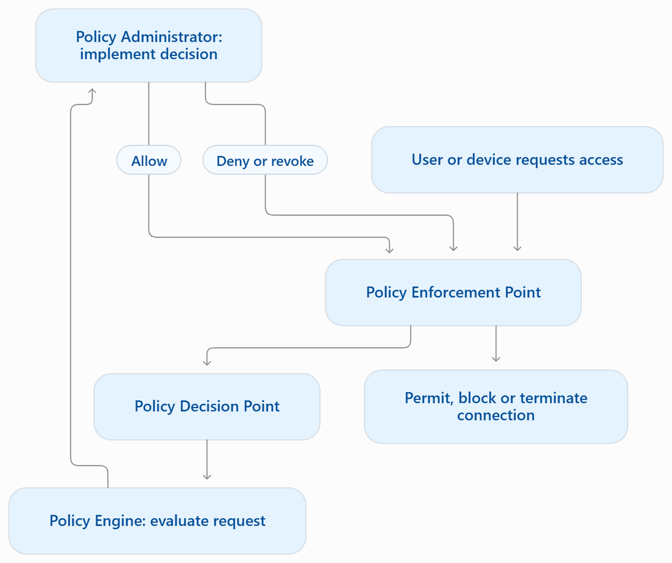
  PE = Evaluates the request.
  PA = Implements the decision.
  PDP = PE + PA.
  PEP = Enforces the decision.

Slide 28
Security zones group systems or network resources according to security requirements.
Implicit trust means assuming something is safe without independently verifying the relevant access request.
Example: Automatically allowing every device on the internal network to access a database.
This is contrary to the Zero Trust principle. Being inside the network is not, by itself, sufficient reason to grant access.

Slide 29
deception & disruption strategies
1. Honeypot — A fake system
A decoy computer, server or application designed to attract attackers and study their tactics & tools
2. Honeynet — A network of fake systems
A collection of interconnected honeypots that simulates a larger network. Defenders observe how the attacker moves between them.
3. Honeyfile — A fake file
A decoy document that appears to contain valuable or confidential information. Detect attempts to access or steal data
4. Honeytoken — Fake information used as a trap
A decoy piece of data, such as a fake username, password, API key or database record. Its use can trigger an alert.

Slide 30
change management
  change management is a systematic approach to managing changes in an organization, ensuring they do not negatively impact security or performance.
  types of change: software deployment, system updates, software patching, hardware replacements, upgrades, network modification, system configurations, new product implementations, new software integrations, support, environment changes.
  The change management process involves documentation, risk assessment, approval, and review.

Slide 31
Three important factors affecting change management
1.Change management approval process
  begins with submitting a request for change
  reviewed by a designated change manager or committee.
  followed by formal approval involving stakeholders
  ocumentation and communication throughout the proces
2. Ownership
  The owner is the person or team accountable for coordinating the change.
  ensuring it is implemented as planned, managing risks and communicating progress.

Slide 32
3. Stakeholders
  individuals or groups who may be affected by the change or have an interest in its outcome.
  Examples include system users, IT staff, management and customers.

Slide 33
Change Management Concepts
  Impact analysis: Identify and assess how a proposed change could affect users, business processes, systems, security, and operations.
  Test results: Test the change in a controlled environment before deploying it to the live system. ensure changes work as intended, identify potential issues.
  Backout plans: contingency plans for reversing changes. minimize downtime and reduce risk of data loss
  maintenace window: A predefined schedule for implementing a change, preferably during periods of low activity to reduce disruption.
  standard operating procedure: detailed instructions for routine operations or changes.

Slide 34
Technical Implications of Change Management
1. Allow lists and denial lists
  Allow list: A list of approved software, hardware, users, or change types. reduce time and effort for trusted changes, ensure alignment with organization. e.g. routine or low-risk changes
  Denial list: A list of explicitly blocked software, hardware, users, or change types. block unauthorized, high-risk changes, clearly identify unauthorized changes. e.g. software with known security issues, high-impact changes, or unauthorized individuals.

Slide 35
2. Restricted activities
  certain activities are deliberately restricted or tightly controlled because they can introduce instability, security risks, or compliance violations if not managed properly.
  Downtime and restarts: directly affect business operations. minimize disruptions by scheduling during maintenance windows or off-peak times. ensure that stakeholders are aware of service outages to prepare accordingly. e,g. Service restart: Stops and starts a background service or system process or Application restart: Closes and relaunches an application, creating a fresh running instance.

Slide 36
3. legacy applications
  unique challenges in managing changes due to outdated technology and lack of support.
  It requires specialized solutions and expensive testing.
4. Dependencies
  Dependencies occur when one application, service, or system relies on another to function correctly.
  Dependencies can extend to the time needed for changes and backup plans.
5. Documentation
  Change documentation records what was changed, why it was changed, who approved it, and whether it was successful.
  Documentation should include: Change description and reason, Risk and impact assessment., Approval details and responsible personnel., Implementation steps and test results, Backup and rollback procedures, Updated system configurations and network diagrams, New or changed dependencies, Recovery procedures and employee training requirements.

Slide 37
6. version control
  track and control changes to documents and dats
  assess how changes impact existing policies, procedures, and diagrams.
  label new versions, archive old ones.

Slide 38
cryptographic solutions
  cryptography: art of making information secure by encoding it
terminology
  plaintext: unecrypted message
  ciphertext: encrypted message
  algorithm: process used to encrypt and decrypt a message
  cryptoanalysis: art of cracking cryptographic solutions

Slide 39
public key infrastructure
  Public Key Infrastructure (PKI) is the complete system used to manage cryptographic keys, digital certificates, policies, and trust between users, devices, and organizations.
  It helps verify that a public key belongs to the person, organization, or device it claims to represent.
Main functions of PKI
  Key pair management: Supports the generation and management of public and private keys.
  Certificate management: Issues, validates, renews, and revokes digital certificates.
  Policies and procedures: Establishes rules for how keys and certificates must be used and protected.

Slide 40
  Trust management: Allows systems to verify that a public key is associated with the claimed identity.
  Security: Helps protect communications, verify digital signatures, and support secure authentication.
public key cryptography
  Uses public (encryption) and private (decryption) keys for cryptographic operations.
  digital signature: sign with private key, verify with public key

Slide 41
key escrow
  involves the secure storage of a copy of a cryptographic key with a trusted third party, called an escrow agent, so that the key can be recovered under authorized conditions.
  making multiple copies increases the risk of compromise and makes detection difficult.
  M-of-N control requires a minimum of M authorised people out of N total designated people to approve or perform a sensitive operation. it prevents a single individual from performing key recovery operations

Slide 42
Encryption and Data Protection
The three states of data
  Data at rest: data that is stored and not currently being transmitted. e.g. Hard drives, USB devices, backup tapes, cloud storage. Protection: Full disk, volume, file, or database encryption.
  Data in transit: data moving between systems over a network. e.g. Online banking, email transmission, file transfers. Protection: TLS, IPsec, and WPA3 for supported Wi-Fi communications.
  Data in use: data currently being processed by a computer, usually in memory. e.g. An open document, data being processed by an application, database records loaded into RAM. Protection: Access controls, process isolation, and specialised confidential-computing techniques.

Slide 43
Types of encryption
  Bulk encryption
  encrypts large amounts of data (MB or GB)
  symmetric ciphers: efficient for large data e.g. AES
  Full disk encryption (FDE)
  encrypts entire storage device including metadata and free space. guards against physical theft by requiring user credentials to unlock the decryption key.
  Self-encrypting drives (SEDs)
  have built-in encryption, not exposed to the OS. e.g. HDD, SSD, USB flash drives.
  partition encryption
  allows selective encryption for different partitions e.g. boot, system, data.

Slide 44
5. volume encryption
  encrypts a storage resource with a single file system e.g. microsft bitlocker, apples filevault.
6. file encryption
  encrypts individual files or folders e.g. microsoft EFS.
7. database encryption
  protects data stored in structured databases by encrypting data at various levels such as database-level, record-level, and cell/column level.

Slide 45
type | what it protects | key point
Database-level encryption | Broadly protects database storage, often through transparent data encryption (TDE). | Usually protects data files at rest, not necessarily data after it is decrypted for processing.
Record-level encryption | Protects individual records. | Different records can have separate protection requirements.
Cell/column-level encryption | Protects selected fields or columns. | Useful for highly sensitive values, such as identity or financial information.

Slide 46
Transport encryption
  protects data as it travels across networks
  TLS (Transport Layer Security): Protects communications such as HTTPS connections between a browser and a website.
  IPsec: Protects IP network traffic, commonly for VPNs.
  WPA2/WPA3: Protects wireless network communications.
.
key exchange
  enable secure sharing of symmetric session keys
What protects integrity and authenticity?
  HMAC: Uses a secret key and a cryptographic hash function to help verify data integrity and authenticity.
  Authenticated encryption: Provides confidentiality and integrity, and may provide authenticity, when used correctly. AES-GCM is a common example.

Slide 47
symmetric encryption
  Symmetric encryption uses the same shared secret key to encrypt and decrypt data.
Sender
Original message: plaintext
Shared secret key + encryption algorithm
Encrypts the message
Ciphertext
Encrypted message sent to the receiver
Same shared secret key + decryption algorithm
Decrypts the message
Receiver
Recovers the original plaintext

Slide 48
  symmetric algorithms: agreement on cipher/key, emcryption, transmission, decryption, fast, suitable for large data. secure method needed for key exchange.
  For integrity and authenticity, systems can combine encryption with a message authentication code (MAC), or use authenticated encryption such as AES-GCM.
  Substitution cipher: Replaces characters or groups of characters with different characters. e.g. ROT13 changes HELLO to URYYB.
  Transposition cipher: Keeps the original characters but changes their positions. e.g. TEAM could be rearranged to META.
  Modern algorithms such as AES combine multiple rounds of transformations, including substitution and permutation, to provide strong cryptographic protection.

Slide 49
  AES, DES, 3DES
  The AES cipher allows the use of three key strengths: 128 bits, 192 bits, and 256 bits.
Key length
  A cryptographic key is a value used by an encryption algorithm to encrypt or decrypt data.
  Key length: The number of bits in a cryptographic key.
  Key space: The total number of possible keys an attacker might have to try.
  The longer the key, the more possible combinations an attacker may need to test in a brute-force attack.
  e.g. AES-128 Key space: (2^{128}) possible keys
  larger keys provide stronger security but also consider performance and the algorithm's design.

Slide 50
  Key sizes from different cryptographic algorithms are not directly equivalent.
  For example, RSA and elliptic-curve cryptography (ECC) achieve comparable security with different key lengths. An RSA key of 1,024 bits is not a modern secure recommendation; it is too weak for current security needs. RSA-2048 is a common minimum baseline, while ECC can provide comparable security with much shorter keys.
  ROT13 is a simple substitution cipher that shifts each letter by 13 positions.

Slide 51
asymmetric encryption
  uses two different but related keys (public and private key) for encryption and decryption.
  Public key distribution does not compromise security.
How asymmetric encryption works
Imagine Alice wants to send Bob a confidential message.
Step 1: Bob generates a key pair
Bob keeps his private key secret and shares his public key with Alice.
Step 2: Alice encrypts the message
Alice uses Bob's public key to encrypt her message.
Step 3: Alice sends the ciphertext
The encrypted message travels over the network.
Step 4: Bob decrypts the message
Bob uses his private key to decrypt the original message.

Slide 52
  Intercepting the public key and ciphertext should not enable an attacker to recover the plaintext
Asymmetric algorithms
  RSA: 2,048-bit private key
  ECC: 256-bit private key for high security
  DSA — Digital Signature Algorithm: Designed for creating and verifying digital signatures, rather than encrypting messages. It helps verify authenticity and integrity.

Slide 53
key exchange
  the process of establishing or securely sharing cryptographic key material between two parties so they can communicate securely.
  Asymmetric encryption is generally slower than symmetric encryption, so encrypting an entire large message with public-key cryptography is inefficient.
  Instead, systems commonly use hybrid encryption:
  Asymmetric cryptography helps protect or establish a session key.
  Symmetric cryptography encrypts and decrypts the actual message.
  A session key is a temporary symmetric key used to protect data during a communication session.

Slide 54
How a digital envelope works
Imagine Alice wants to send Bob a large, confidential file.
Step 1: public key acquisition
Alice obtains Bob's public key
Step 2: session key encryption
Alice encrypts message with symmetric key.
Step 3: session key encryption with public key
Alice encrypts the session key with Bobs public key
Step 4:digital envelope
Alice sends encrypted session key and ciphertext
.

Slide 55
Step 5: session key decryption
Bob decrypts session key with private key
Step 6: message decryption
Bob uses the recovered session key to decrypt the ciphertext.
#in-band key exchange: is on the network. protect key with additional encryption such as TLS
#out-of-band key exchange: don’t send symmetric key over the net

Slide 56
tools
  dedicated servers or applications generate and store keys e.g TPM, HSM, KSM, Secure Enclaves.
Trusted Platform Module (TPM)
  Protects keys and supports measured boot, platform-state checks and attestation.
  Common TPM functions include: Secure key storage, Random number generation, Remote attestation (Helps a remote verifier assess boot measurements and system state.), Binding (Protects data so it can be recovered using the appropriate TPM-associated key.), Sealing (Protects data so that access or unsealing depends on specified TPM or platform-state conditions.)

Slide 57
Hardware Security Module (HSM)
  A Hardware Security Module is a specialised hardware device designed to generate, protect, store and use cryptographic keys.
  Typical uses include: Protecting certificate-authority signing keys, Generating and protecting encryption keys, Performing digital signatures and cryptographic operations, Providing controlled access to sensitive key material.

Slide 58
Key Management System (KMS)
  A Key Management System (KMS) manages cryptographic keys throughout their lifecycle
Key lifecycle
  Generation: Create asymmetric key pair or symmetric secret key
  Storage : prevents unauthorized access and loss/damage
  Revocation: Prevent further use when a key is compromised or no longer trusted.
  Expiration and renewal: shelf-life enhances security. renewal with same or new key pair.
decentalised km: Keys are managed separately by individual applications, devices or users.
centralised km: Policies and lifecycle operations are managed through a central service. e.g KMS

Slide 59
secure enclave
  protects decrypted data in system memory from unauthorized access.
  security prevents access by untrusted processes, even with root or system privileges.
  implemented by Trusted Execution Environment (TEE) like Intel Software Guard Extensions

Slide 60
obfuscation
  holds data to make it difficult to find
steganography
  the technique of concealing secret information within an ordinary-looking file or communication medium to prevent the existence of the message from being detected.
  conceals the very existence of the communication
  The image, document or other medium used to conceal the information is commonly referred to as the cover medium
  The hidden message may be encrypted before embedding, thereby combining cryptography and steganography to provide an additional layer of security

Slide 61
data masking
  used to conceal sensitive information by replacing some or all of its characters with substitute characters, such as Xs, asterisks, or blank spaces.
  a credit card number may be displayed as **** **** **** 1234
  used to prevent unauthorized users from viewing sensitive information in applications, databases, reports, and other information systems.
  Techniques associated with data masking include character substitution, shuffling, encrypting, masking out etc.

Slide 62
tokenization
  replaces sensitive information with a non-sensitive substitute known as a token.
  tokens and original values are stored separately in a token server or vault
  used as a substitution for encryption
Hashing
  represent data as a short string of text
  one-way function (impossible to recover plaintext) and collision-resistant (unlikely for different inputs to produce the same output).

Slide 63
#integrity verification: 1. password comparison: hashes compared to verify psswords. 2. file integrity: hashes compared to verify file integrity
cryptographic hash algorithms
  the Secure Hash Algorithm (SHA) family and the Message Digest 5 (MD5) algorithm
  SHA-1 and MD5 have known collision weaknesses and should not be used where collision resistance is required for security
  SHA-256, SHA-512, and suitable SHA-3 variants remain widely used for cryptographic integrity applications.

Slide 64
Hash-Based Message Authentication Code (HMAC)
  a security mechanism that combines a cryptographic hash function, such as SHA-256 or SHA-3, with a shared secret key to verify message integrity and authenticity.
  Both the sender and recipient must know the secret key to generate or verify the HMAC
  Unlike digital signatures, HMAC does not provide non-repudiation because both parties share the same secret key.

Slide 65
digital signatures
  combines hashing and public-key cryptography to provide message integrity, authentication and support for non-repudiation.
How it works:
  Hashing: Alice generates a message digest using a secure hash algorithm, such as SHA-256 or SHA3-512.
  Signing: Alice uses her private key to create a digital signature over the digest.
  Sending: Alice sends the message together with the digital signature to Bob.
  Verification: Bob uses Alice’s public key to verify the signature and independently hashes the received message.
  Comparison: If verification succeeds, Bob gains evidence that the message has not been altered and that the signature was generated using the corresponding private key.

Slide 66
Digital Certificates
  electronic document that links an entity's identity to its public key.
  It is issued and digitally signed by a trusted Certificate Authority (CA), which helps other parties verify that the public key belongs to the claimed entity.
  follow the X.509 standard and are used to secure websites, email, devices and digitally signed software.

Slide 67
Certificate revocation
  Certificate Revocation List (CRL): A published list of revoked certificates. Revoked certificate or Suspended certificate.
  Online Certificate Status Protocol (OCSP): Allows a client to query a service for a certificate's revocation status.

Slide 68
Types of certificates and certificate authorities
Type | Explanation
Self-signed certificate | Signed using its own private key rather than a trusted CA. Common in testing and private environments, but requires a separate method of establishing trust.
Third-party CA | Root certificate authority issues certificates to intermediate certificate authorities, which in turn issue certificates to end entities.
Root CA | establishes trust between users and certificate authorities by using root certificates, which are self-signed by the certificate authority and used to sign other certificates.
Single-CA model | The root CA directly issues certificates to users and computers, often used on private networks, vulnerable because if compromised, the entire PKI collapses

Slide 69
key stretching
  increases key length through multiple iterations.
  uses algorithms such as PBKDF2, which repeatedly applies hashing and other operations to increase the time required for attackers to test password guesses.
Salting
  prevents precomputed hash attacks by adding random value (salt) to passwords.
  Salting helps defend against precomputed attacks, such as rainbow-table attacks, and makes large-scale password cracking less efficient.

Slide 70
blockchain
  distributed digital ledger that records transactions across multiple computers.
  Information is stored in blocks linked together using cryptographic hashes.
  Each block typically contains transaction data, a timestamp, and the hash of the previous block.
  This linking makes unauthorized changes detectable and helps protect the integrity of the records.
  decentralized: Public blockchains can operate without a central transaction-processing authority.
  Applications: Cryptocurrency, Property records, supply chain management, Asset tracking.

Slide 71
subject alternative name (san)
  an extension in a digital certificate that specifies the identities the certificate covers, such as fully qualified domain names (FQDNs), subdomains and IP addresses.
  Browsers use SAN entries to verify that a website's identity matches its certificate.
  A single certificate can include multiple domain names, and SAN entries may include wildcard domains where supported.
  Example: A single certificate can cover example.com, example.org and example.net.

Slide 72
wildcards
  A digital certificate that secures multiple subdomains under the same domain using a wildcard (*).
  It simplifies certificate management and can reduce costs, but if its private key is compromised, all covered subdomains may be affected.
  Example: *.example.com can cover www.example.com, mail.example.com and shop.example.com

